Slide 1
Technology Based Inventory System
William Askew, Andrew Goyer, Victor Kondzielawa, Nathan Pham

Slide 2
Overview
cstechinventory.000webhostapp.com is a website for companies to easily track their IT equipment. A company with multiple branches will be able to know how much equipment they have, where it is located, and the date it is was added in to see if equipment is outdated. Through our seamless design of the website, any user will be able to easily update the database as long as they have admin privileges.

Slide 3
Database Overview
Using PHPmyAdmin we were able to use SQL to hold our IT equipment entries. Each item had associated fields to specify variations within items.
Fields to the database include: Serial Number, Item, Make, Model, Location, ID, Date Added

Slide 4
Requirements
Functional Requirements:
The user will login into the system
The user will be able to add items to the database through a web form
The user will be able to remove items from the database through a web form
The user will be able to search for items that are already in the database
The user will be able to view all the entries within the database from single page
Non-Functional Requirements:
Must be simple to use for everyone
The GUI must be clean and easy to read
Must perform all tasks within a reasonable amount of time
Must be secure from non authorized users
Must be complete and correct

Slide 5
Page Overview
Login
Add
Remove
Search
View All

Slide 6
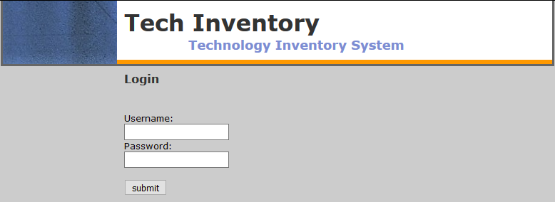
Login
The login page requests a username and a password for entry into our main website

Slide 7
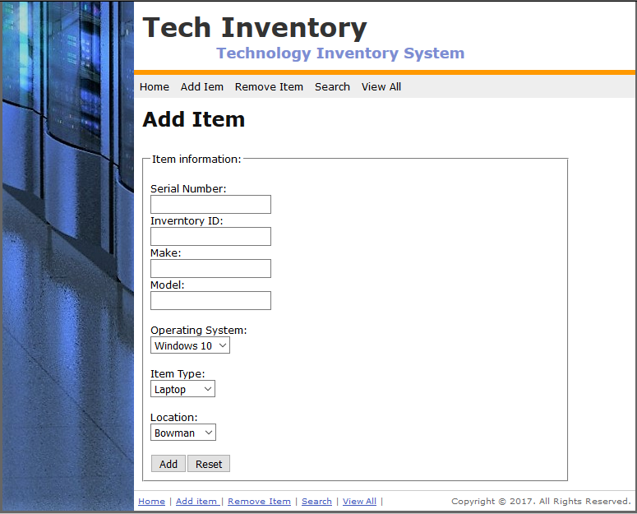
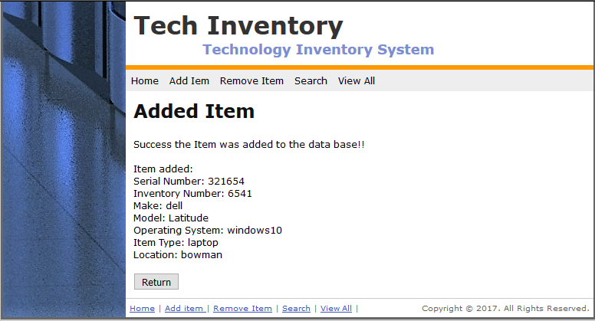
Add
Used to add items based on serial number, inventory ID, item type, and Item location into database for future use.
Buttons include add and reset

Slide 8
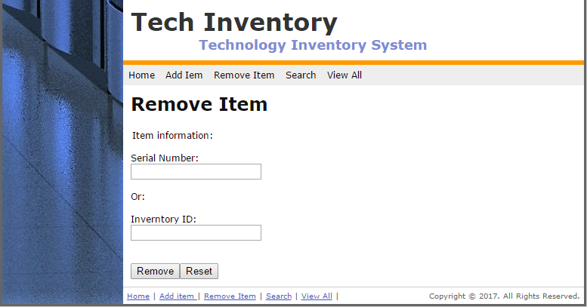
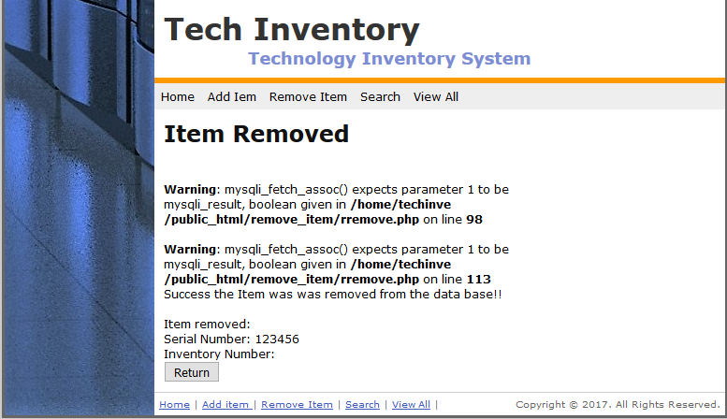
Remove
Used to remove items by searching current database based on serial number or inventory ID number (Item must already be entered into database and the person removing must have either serial number or inventory ID number to locate item)
Buttons - Remove and Reset

Slide 9
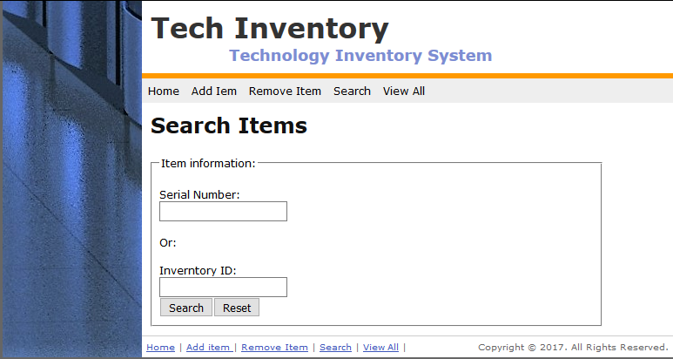
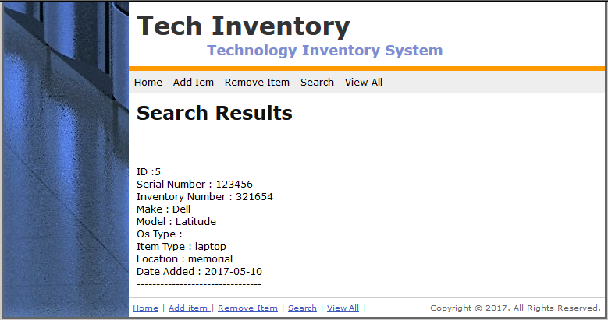
Search
Used by a user to search any item in the database based on serial number/inventory ID, item type, or location.
Buttons - Search and Reset

Slide 10
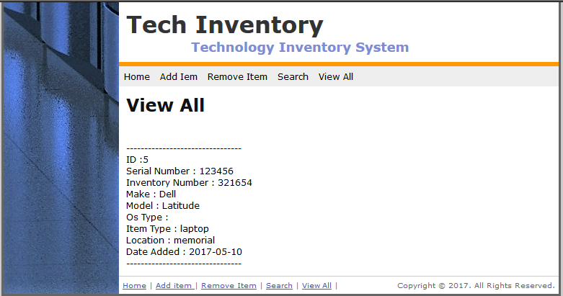
View All
Used to show all of the current entries in the database that have been entered

